Slide 1

Driver and urban traffic monitoring system
1.Vignesh.S
(20BCE1782)
2. NIKHIL VAIDHYANATHAN G (20BCE1898)
3. SHANMUKAPRIYA K
20BCE1803

Slide 2
Changes in abstract
No changes in abstract and the project will be implemented as per the abstracts submitted in review 1

Slide 3
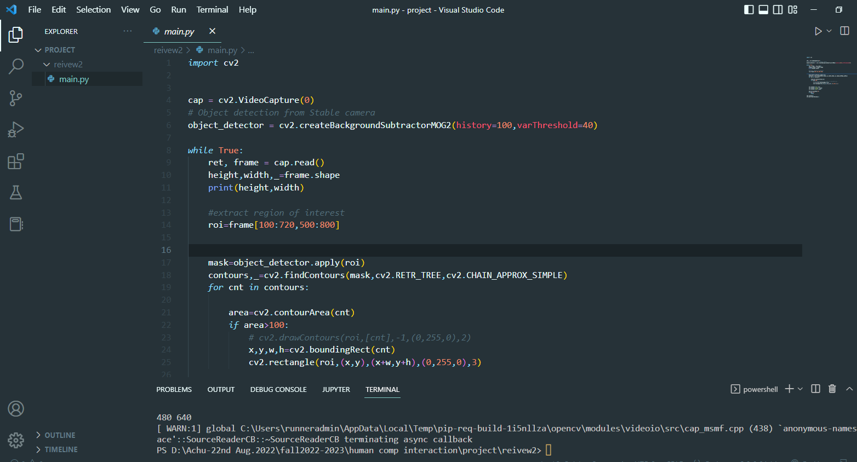
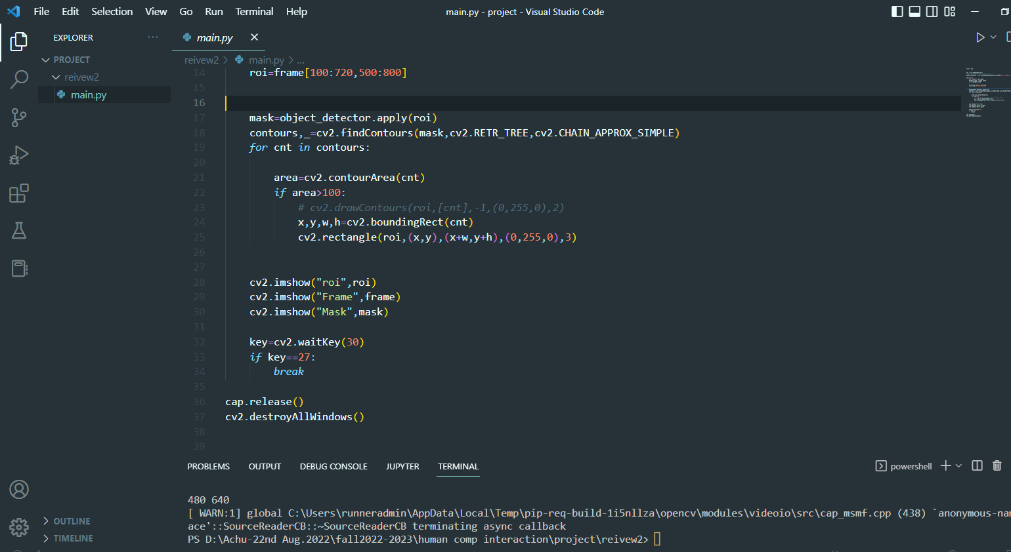
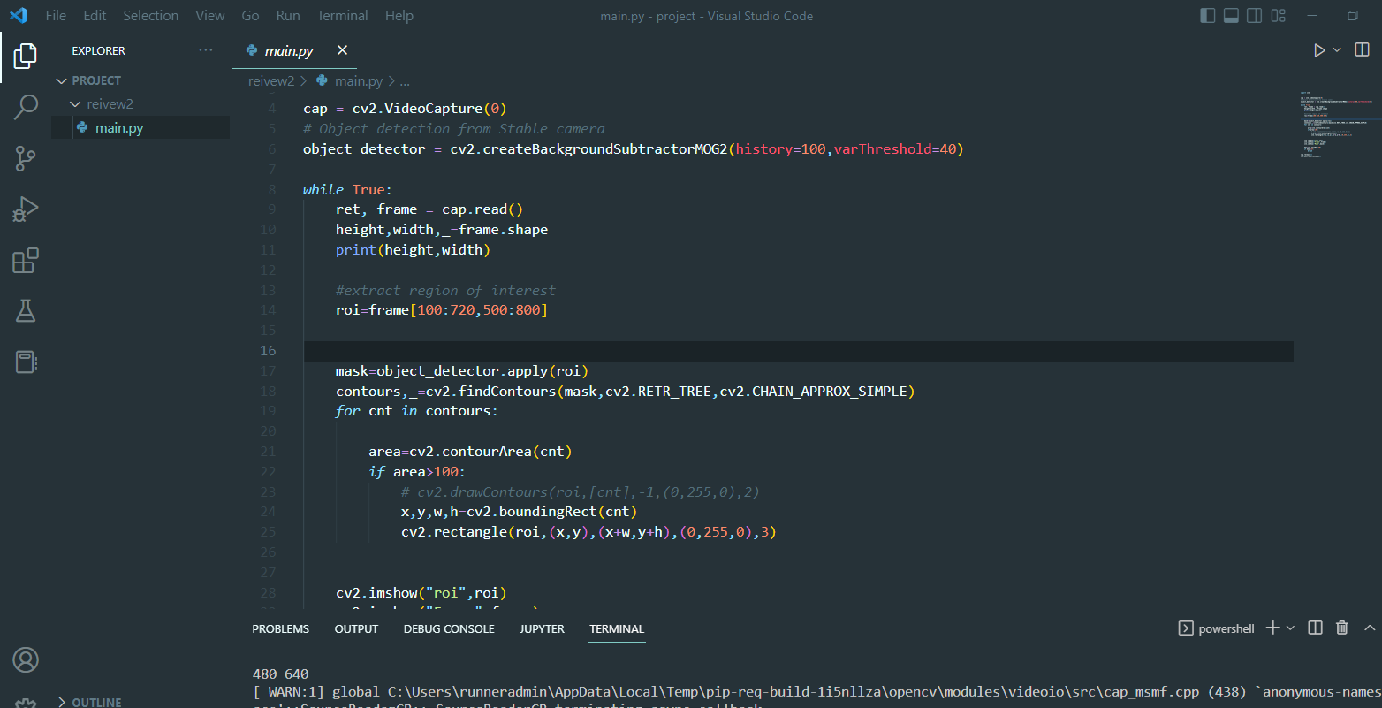
Project status
Coding

Slide 4
Project status
2.Hardware:
ESP32 CAMERA
PHONE CAMERA (ANDROID PHONE)
3. SOFTWARE
VS CODE
GOOGLE COLAB

Slide 5
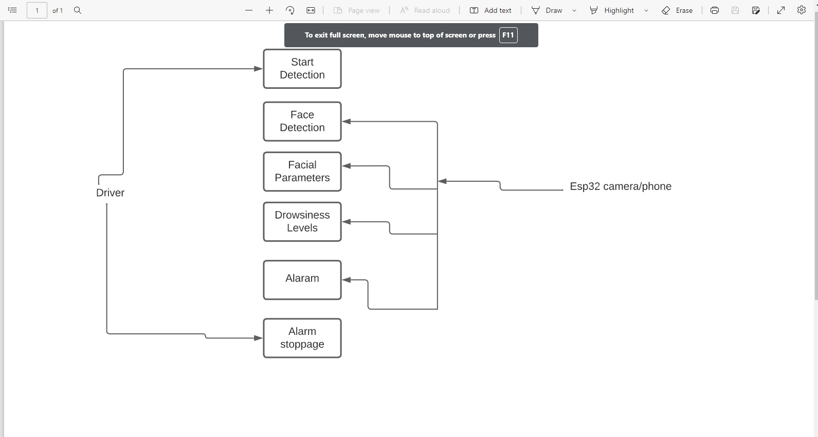
WORKING MODEL
The problem can be solve by using the transfer learning technique in deep learning

Slide 6
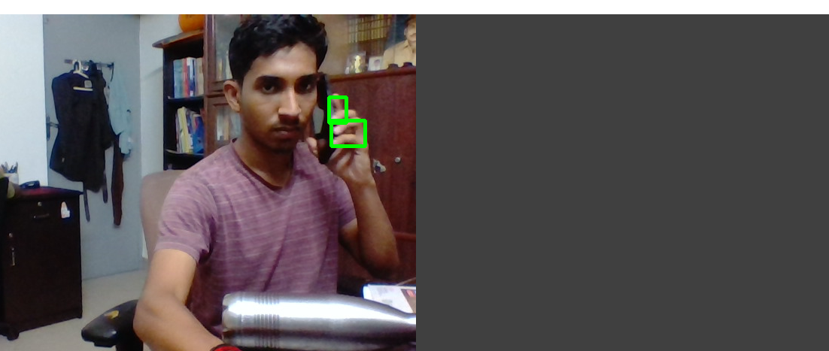
DEMO
Detection of distraction due to cellphone is achieved using opencv library

Slide 7
CONTRIBUTIONS
Vignesh s.-
Attempt to Implement using convolutional neural networks (CNN)
Creating an interface using phone camera by integrating with code from the local machine
Nikhil:
Attempt to Implement using convolutional neural networks
SHANMUKAPRIYA K:
Implementation using opencv

Slide 8
REMAINING WORK
Vignesh s and Nikhil.-
Implementing using transfer learning (a deep learning technique)
SHANMUKAPRIYA K :
Deciding and implementing a more effective interface by choosing between esp32 camera and an android phone

